Slide 1
BT201
Biochemical Process Calculations
15/11/2022

Slide 2
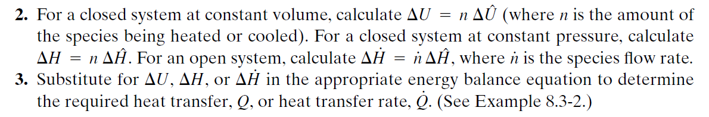
Energy Balances on Single-Phase Systems
Energy balances on any processes that do not involve phase changes, or chemical reactions.
If a process only involves heating or cooling a single species from T₁ to T₂ , the procedure is straightforward:

Slide 3
CONT..
If more than one species is involved
or if there are several input or output streams instead of just one of each,
the procedure ALREADY DISCUSSED
Choose reference states for each species,
prepare and fill in a table of amounts and specific internal energies (closed system) or species
or flow rates and specific enthalpies (open system),
and substitute the calculated values into the energy balance equation.

Slide 4
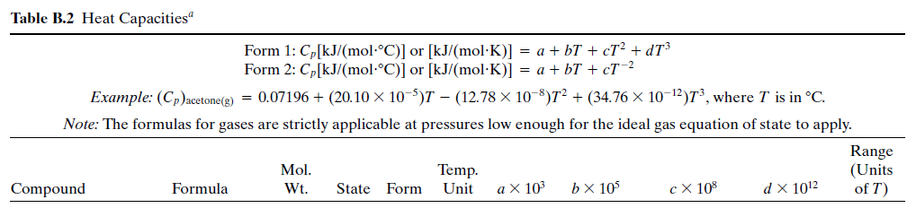
Energy Balance on a Gas Preheater
A stream containing 10% CH₄ and 90% air by volume is to be heated from 20 °C to 300 °C. Calculate the required rate of heat input in kilowatts if the flow rate of the gas is 2.00 x 10³ liters (STP)/min.

Slide 5
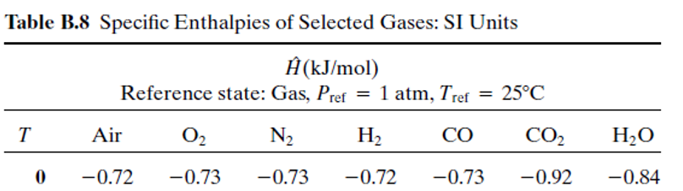
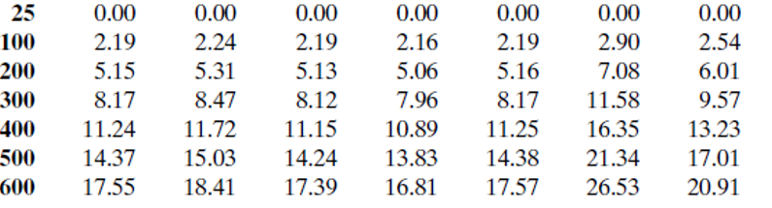
20 -0.15 NA NA NA NA NA NA

Slide 6
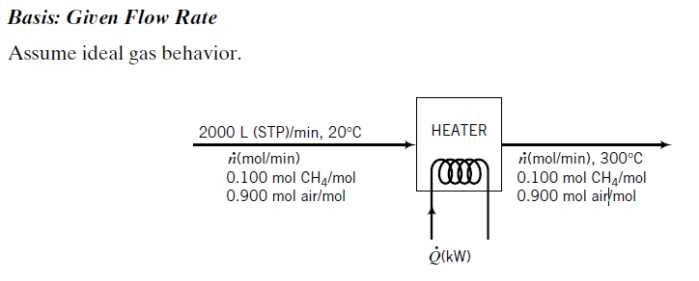



Slide 7
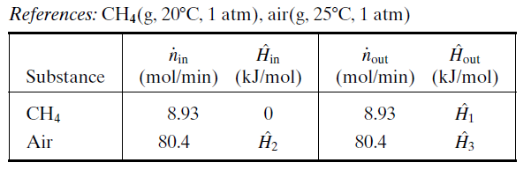
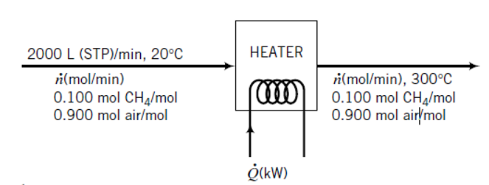
The reference condition for methane was chosen so that $\hat{H}$_{in} could be set equal to zero,
and that for air was chosen so that $\hat{H}$_{in} and $\hat{H}$_{out} could be determined directly from Table
The next step is to evaluate all of the unknown specific enthalpies in the table.
We neglect the effect of pressure on enthalpy (i.e., we assume ideal gas behavior)

Slide 8
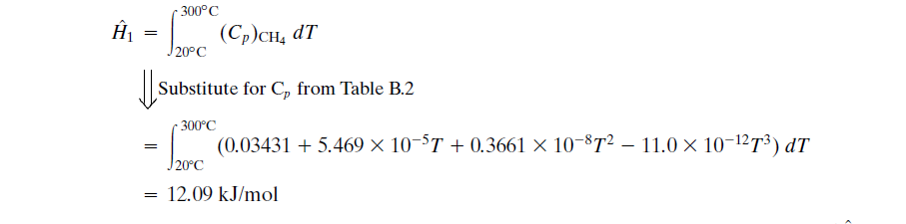
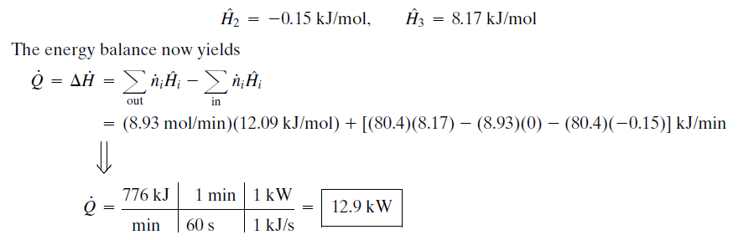
From table,

Slide 9

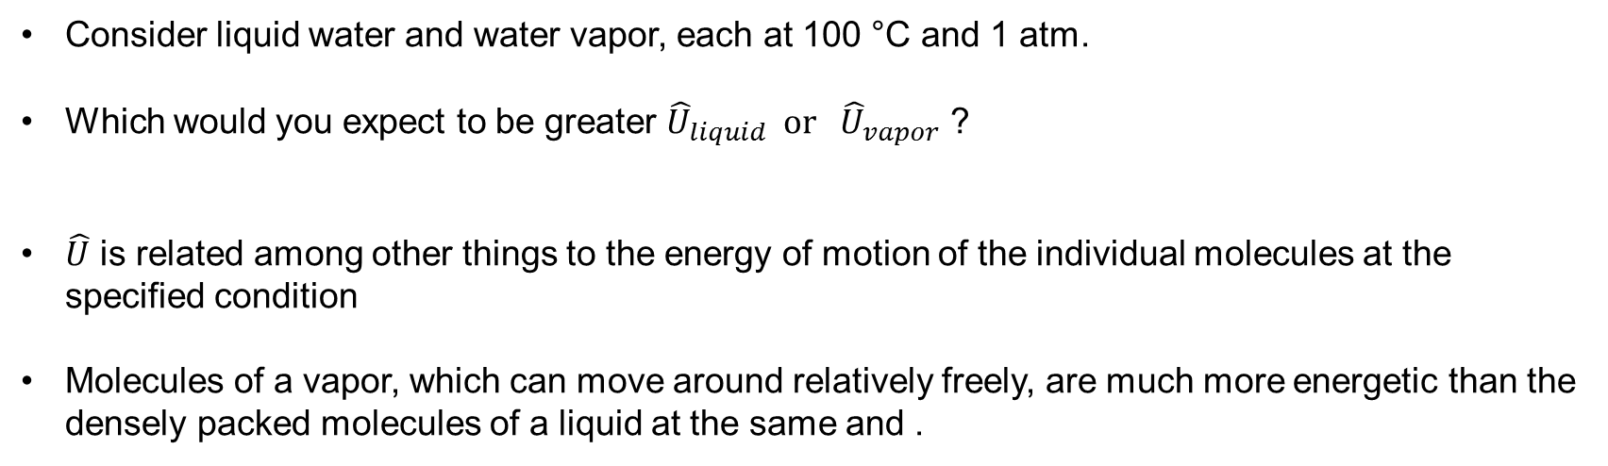
Phase change operation
Consider liquid water and water vapor, each at 100 °C and 1 atm.
Which would you expect to be greater ${\hat{U}}_{liquid} or {\hat{U}}_{vapor}$ ?
$\hat{U}$ is related among other things to the energy of motion of the individual molecules at the specified condition
Molecules of a vapor, which can move around relatively freely, are much more energetic than the densely packed molecules of a liquid at the same and .
difference between ${\hat{U}}_{liquid} or {\hat{U}}_{vapor}$ ?

Slide 10

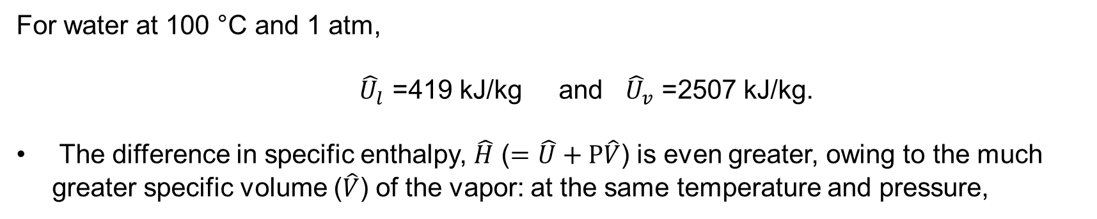
For water at 100 °C and 1 atm,
${\hat{U}}_{l}$ =419 kJ/kg and ${\hat{U}}_{v}$ =2507 kJ/kg.
The difference in specific enthalpy, $\hat{H}$ ($=\hat{U}+P\hat{V}$) is even greater, owing to the much greater specific volume ($\hat{V}$) of the vapor: at the same temperature and pressure,
${\hat{H}}_{l}$ =419 kJ/kg and ${\hat{H}}_{v}$ =2676 kJ/kg.
Phase changes such as melting and evaporation are usually accompanied by large changes in internal energy and enthalpy
Heat transfer requirements in phase-change operations consequently tend to be substantial, since $Q=∆U$ (closed constant volume system) or $\dot{Q}=∆\dot{H}$(open system).

Slide 11
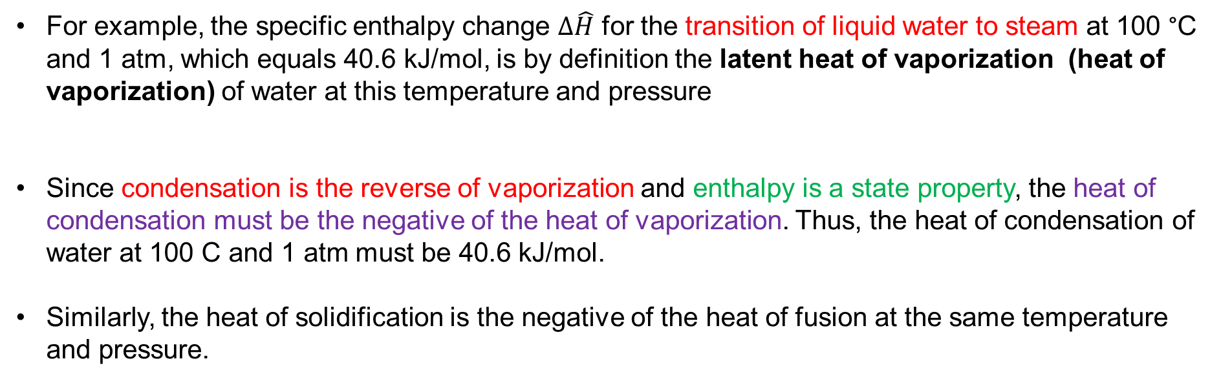
Latent heat
Latent heat: The specific enthalpy change associated with the transition of a substance from one phase to another at constant temperature and pressure is known as the latent heat of the phase change.
(as distinguished from , sensible heat which is associated with temperature changes for a single- phase system)
For example, the specific enthalpy change $∆\hat{H}$ for the transition of liquid water to steam at 100 °C and 1 atm, which equals 40.6 kJ/mol, is by definition the latent heat of vaporization (heat of vaporization) of water at this temperature and pressure
Since condensation is the reverse of vaporization and enthalpy is a state property, the heat of condensation must be the negative of the heat of vaporization. Thus, the heat of condensation of water at 100 C and 1 atm must be 40.6 kJ/mol.
Similarly, the heat of solidification is the negative of the heat of fusion at the same temperature and pressure.

Slide 12
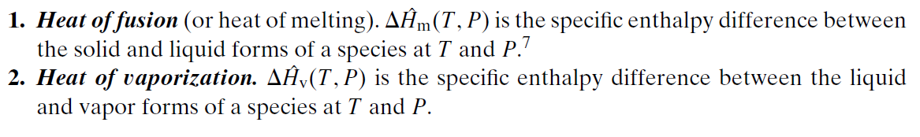
Latent heats for the two most commonly encountered phase changes are defined as follows:
Tabulated values of these two latent heats, in handbook usually apply to a substance at its normal melting or boiling point—that is, at a pressure of 1 atm. These quantities are referred to as standard heats of fusion and vaporization.
The latent heat of a phase change may vary considerably with the temperature at which the change occurs but hardly varies at all with the pressure at the transition point.
For example, the heat of vaporization of water at 25 °C is 2442.5 J/g at 23.78 mm Hg and 2442.3 J/g at760 mm Hg
When using a tabulated latent heat, you must therefore be sure that the phase change in question takes place at the temperature for which the tabulated value is reported, but you may ignore moderate variations in pressure

Slide 13
Phase changes often occur at temperatures other than the temperature for which the latent heat is tabulated. When faced with this situation, you must select a hypothetical process path that permits the available data to be used
Suppose, for example, that a substance is to be vaporized isothermally at 130 °C, but the only available value of the heat of vaporization is at 80 ° C.
A process path from the liquid at 130 °C to the vapor at the same temperature must then be chosen that includes an isothermal vaporization step at 80 ° C: specifically, cool the liquid from 130 °C to 80 °C, vaporize the liquid at 80 °C, and then heat the vapor back to 130 °C.
Summing the changes in enthalpy for each of these steps yields the change in enthalpy for the given process. (By definition, the calculated value is the latent heat of vaporization at 130 °C.)

Slide 14
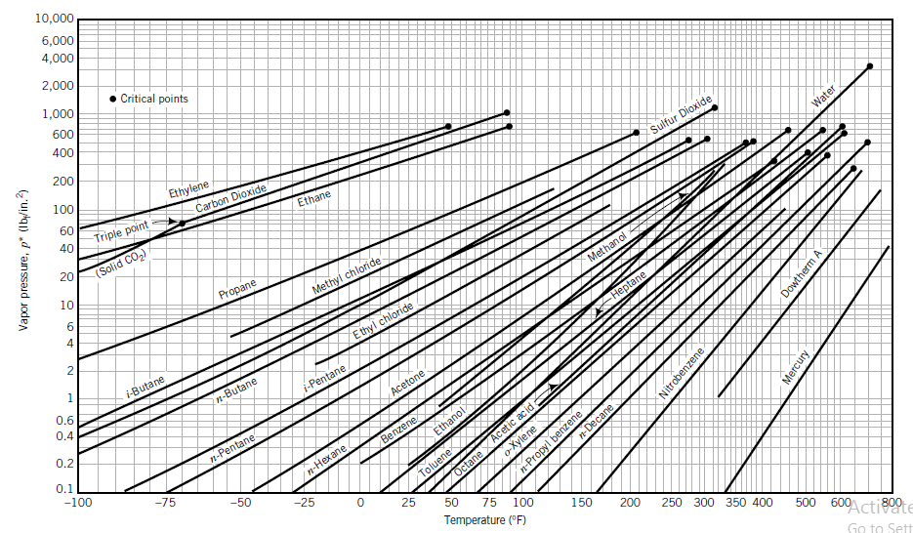

One hundred g-moles per hour of liquid n-hexane at 25 °C and 7 bar is vaporized and heated to 300 °C
at constant pressure. Neglecting the effect of pressure on enthalpy, estimate the rate at which heat
must be supplied.
Cox chart vapor pressure plots

Slide 15
Table: selected physical property data
**Heat of vaporization at T_{b} (69 °C) and 1 atm.

Slide 16
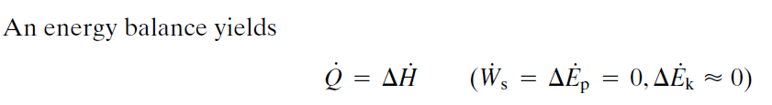

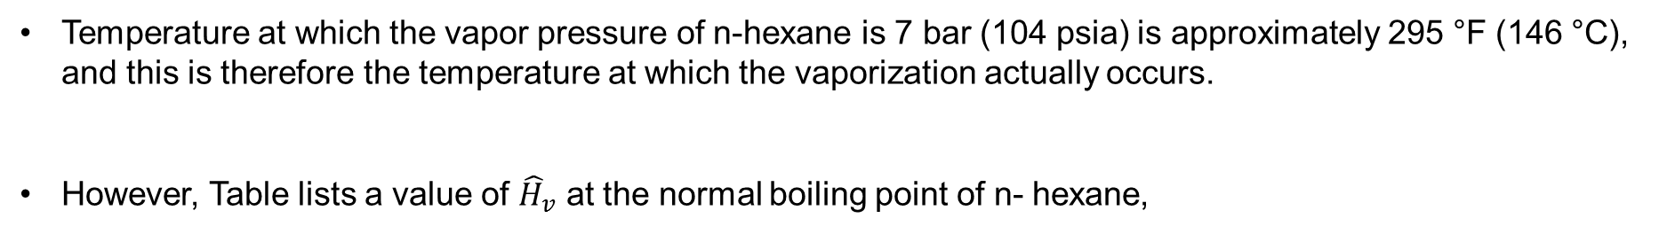
Temperature at which the vapor pressure of n-hexane is 7 bar (104 psia) is approximately 295 °F (146 °C), and this is therefore the temperature at which the vaporization actually occurs.
However, Table lists a value of ${\hat{H}}_{v}$ at the normal boiling point of n- hexane,
We must therefore find a path that takes hexane from a liquid to a vapor at 69 °C, rather than at the true vaporization temperature of 146 °C.
As noted previously, the change in enthalpy associated with a process may be determined from any convenient path as long as the initial and final points of the chosen path correspond to those of the process.

Slide 17
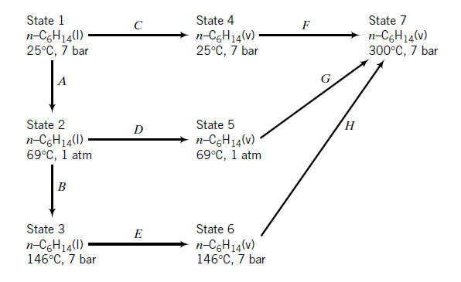
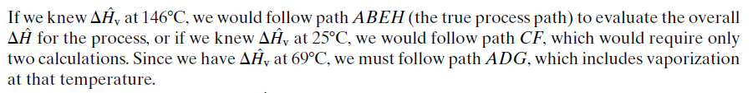
The diagram shown on the following page illustrates several possible paths from liquid
hexane at 25 °C to hexane vapor at 300 °C.

Slide 18
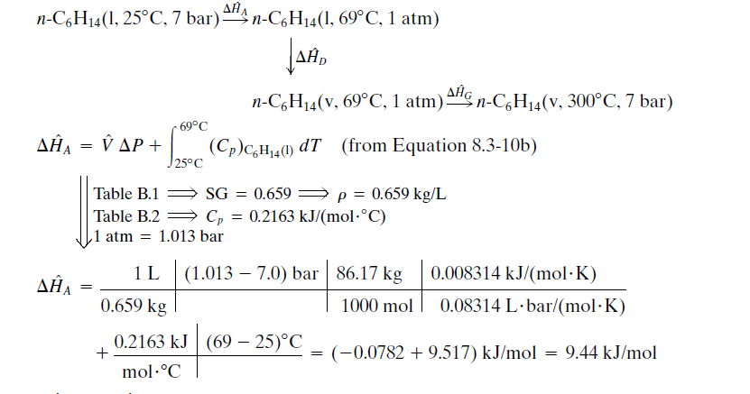

Slide 19
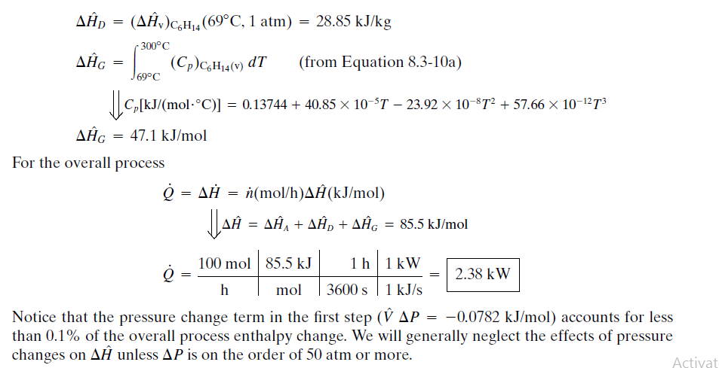

Slide 20



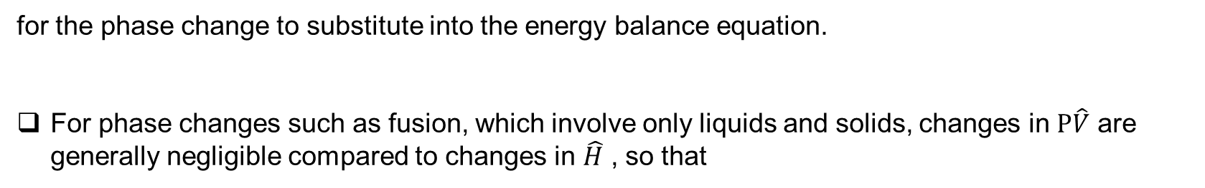
Latent heat
If a phase change takes place in a closed system, you must evaluate
for the phase change to substitute into the energy balance equation.
For phase changes such as fusion, which involve only liquids and solids, changes in $P\hat{V}$ are generally negligible compared to changes in $\hat{H}$ , so that

Slide 21


Estimation and Correlation of Latent Heats
where T_{b} is the normal boiling point of the liquid. Trouton’s rule provides an estimate of ${\hat{∆H}}_{v}$ accurate to within 30%.
Another formula that provides roughly 2% accuracy is Chen’s equation
where T_{b} and T_{C} are the normal boiling point and critical temperature in kelvin and P_{C} is the critical pressure in atmospheres.

Slide 22

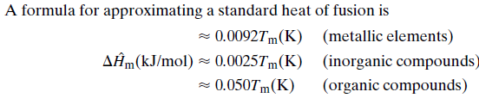
Latent heats of vaporization may be estimated from vapor pressure data by using the
Clausius–Clapeyron equation

